Slide 1
Logic If, else if & else
Module 01
Data Science Developer

Slide 2
Assignment Operators

Slide 3
Assignment Operators
usiaAndi = 40;
usiaAndi *= 2;
print(usiaAndi);
usiaAndi /= 2;
print(usiaAndi);
usiaAndi += 2
print(usiaAndi);
usiaAndi -= 2
print(usiaAndi);
usiaAndi %= 2
print(usiaAndi);

Slide 4
Comparison Operators
== value sama, dan data type sama
> lebih dari
< kurang dari
>= lebih dari sama dengan
<= kurang dari sama dengan
Logical Operators
and (keduanya benar, maka TRUE)
or (salah satu benar, maka TRUE)
not (membalik logika TRUE/FALSE)

Slide 5
Comparison Operators
x = 5;
y = '5';
print(x == y);
print(x > int(y));
print(x >= int(y));
print(x < int(y));
print(x <= int(y));

Slide 6
Logical Operators
x = 5;
y = '5';
z = 6;
print(x==int(y) and int(y)<z);
print(x==int(y) or int(y)<z);
print(not(x==int(y) or int(y)<z));

Slide 7
If, else if & else
if (condition) :
program;
elif (condition) :
program;
else :
program;

Slide 8
If, else if & else
nilai = 40;
if (nilai > 80) :
print('Excellent!');
elif (nilai >= 60 and nilai <= 80) :
print('Good job!');
else :
print("Don't give up!");

Slide 9
If, else if & else
jomblo = True;
if (jomblo) :
print('Masih jomblo!');
else :
print('Udah taken!');

Slide 10
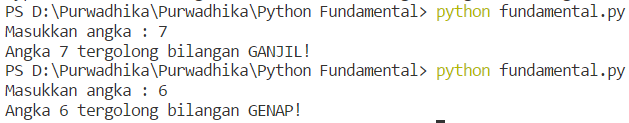
Solve it! #1

Slide 11
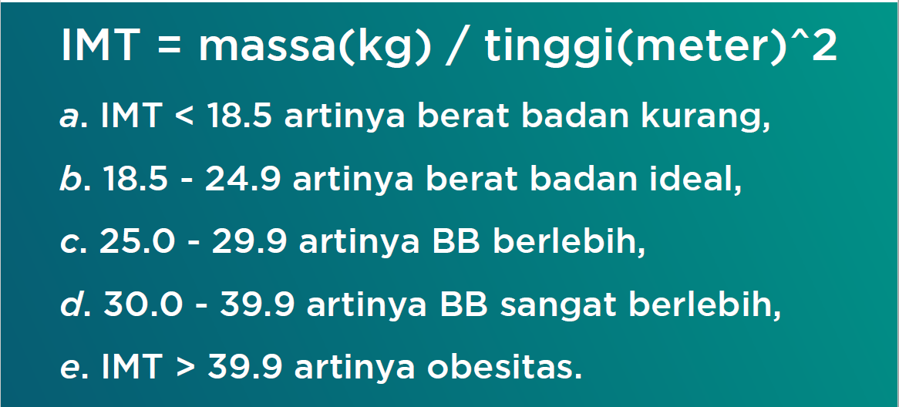

Solve it! #2

